Slide 1
Tides

Slide 2
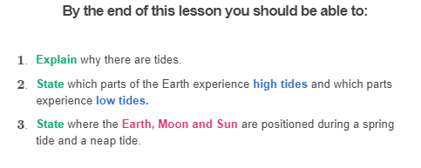

Slide 3
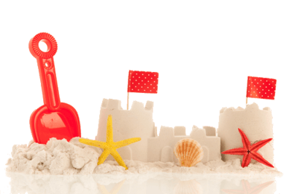
What are tides?
Bella and Emma build a sand castle at the beach and then take a walk. When they return, the castle has been washed away by the ocean. Has something like this happened to you?
Their sandcastle was washed away due to a high tide. Tides are the rise and fall of the levels of the ocean.
They are caused by the gravitational pull of the Sun and Moon, as well as Earth’s own gravity and rotation.

Slide 4
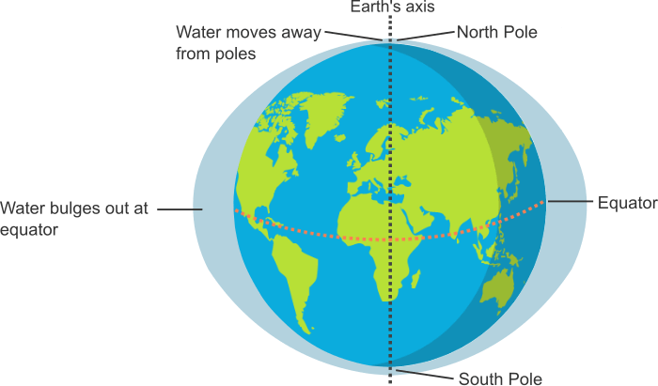
The relative movements of the Sun, Moon and Earth all have an effect on the tides.
Commonly, it is thought that as the Earth spins on its axis, water moves away from the poles and goes towards the equator. In turn, this causes the water at the equator to bulge out at the sides.

Slide 5
When talking about tides, you might often hear that the Moon’s gravitational force pulls the water in the ocean towards it, causing a high tide on the side of the Earth facing the Moon.
This is one bulge, and the bulge of water at the opposite side of the Earth is said to be formed by the Moon’s gravitational force pulling the Earth towards it.
Then, as the Earth rotates it will move through these bulges, meaning different parts of the world will experience high and then low tides.

Slide 6
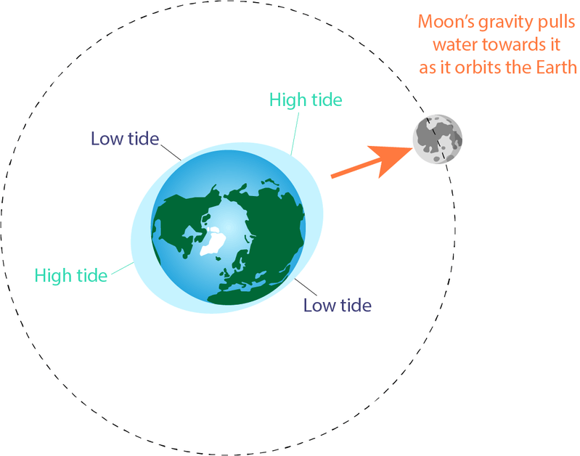

Slide 7
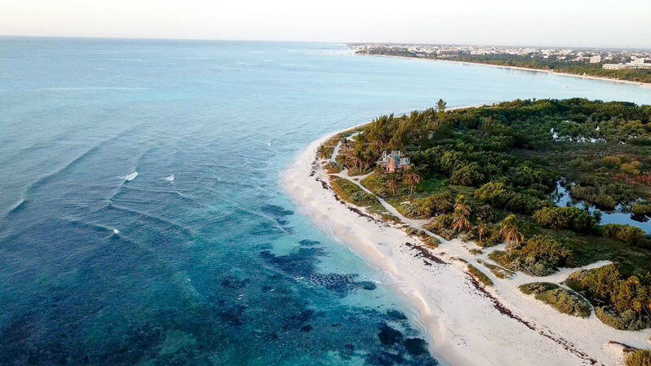
However, this is a simplified way of explaining how tides work on Earth. In reality, tides are much more complex!
In the next part of this section we will dive into the tides more deeply to see what really forms these big bulges of water at each side of the Earth.
Let’s start with the role of the Earth itself in forming tides.

Slide 8
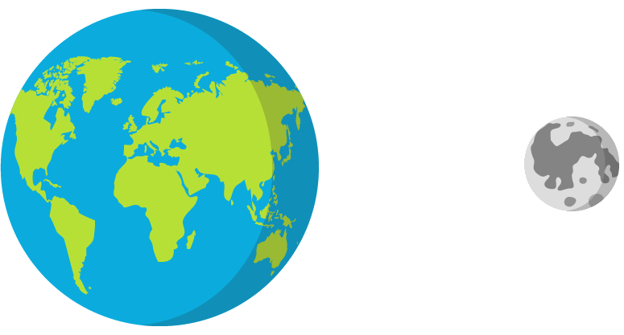
The Earth is big. Very big. This means that it has a reasonably strong gravitational force that draws objects, like us, towards its centre.
The Moon also has a gravitational force drawing objects towards its centre. However, the Moon is a lot smaller than Earth, so its gravity is weaker.
So if the Moon has a weaker gravitational force than Earth, how does it influence our tides so much?

Slide 9
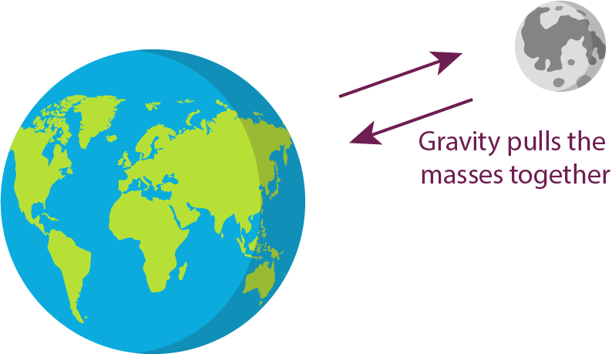
The secret is in the distance between the Earth and the Moon.
Earth and the Moon are reasonably close together in space. The closer together two objects are to each other, the stronger the gravitational pull between them is.
This means that the Earth, and all the molecules of water in the ocean are being pulled slightly towards the Moon. The Moon is also being pulled slightly towards Earth!

Slide 10
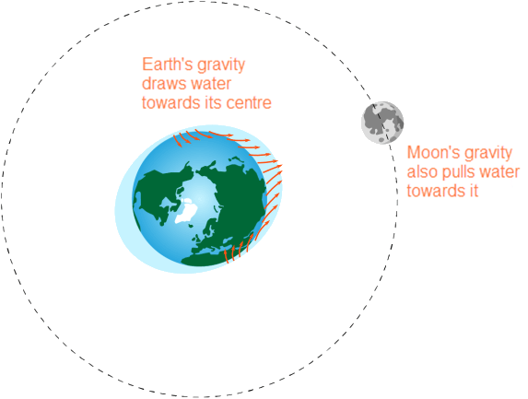
At the same time the ocean’s water molecules are being pulled towards the Moon, they are also being drawn downwards towards the centre of the Earth due to Earth’s powerful gravitational force.
This forces the water molecules downwards. Molecules of water not directly in line with the Moon are pulled almost straight down towards the centre of Earth due to the force of the Earth's gravity.
In contrast, the water molecules in line with the Moon experience the greatest outwards pull towards the Moon.

Slide 11
Since there are countless water molecules in the ocean, the small pull of the Moon's gravity quickly adds up.
The water molecules that aren't directly in line with the Moon are being pulled downward by the Moon's and Earth's gravity end up forcing seawater away from their location.
Similar to squeezing a pimple, this force squeezes the seawater sideways into the tidal bulges we see at the sides of the Earth.
These bulges cause high tides. The areas between the two bulges have a slightly reduced volume of water, and therefore, this results in low tides.

Slide 12
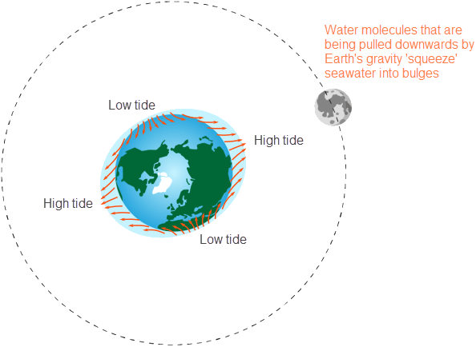

Slide 13
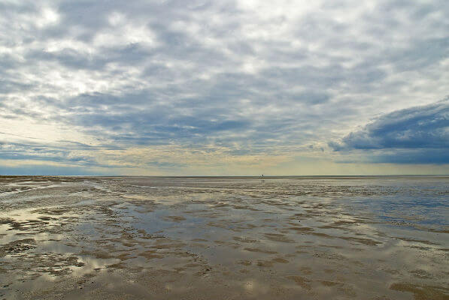
As the Earth rotates on its axis, different areas will move through these bulges formed from the Earth and Moon’s combined gravitational force.
Most places on Earth experience two low tides and two high tides per day. This means that where you are, the tide will move from high tide to low tide approximately every six hours.

Slide 14
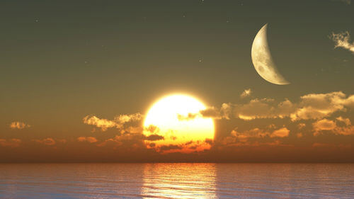
So, what does the Sun have to do with it? Well, the Sun has a small effect on the tides compared to the Moon.
Remember, the Moon’s gravitational force can have a reasonably large effect on our tides since it is quite close to the Earth in space.
Even though the Sun is much bigger than the Moon and it has greater gravitational force as a result, it is also a lot further away from the Earth. Therefore, its effect on our tides is much smaller compared to the Moon.

Slide 15
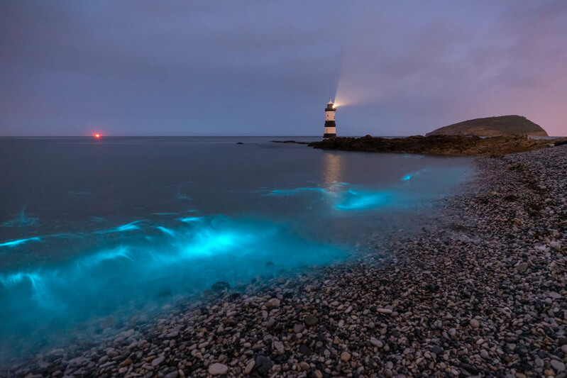
Depending on the position of both the Moon and Sun, the Sun can either enhance or diminish the effect of the Moon’s gravitational force on our oceans.
Let’s find out more!

Slide 16
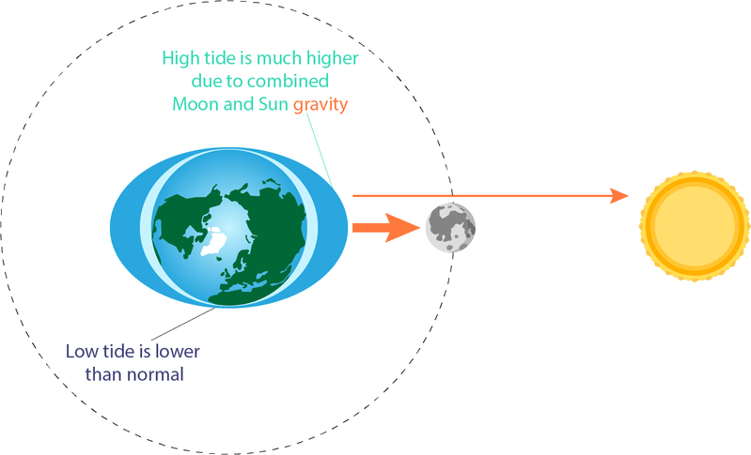
When the Sun and Moon are in line with each other, the Sun increases the gravitational force on the Earth’s oceans.
In this case, the gravitational effects of the Sun and Moon are additive. This causes higher than normal tides, called spring tides. Spring tides occur when there is a full moon or new moon.

Slide 17
When the Sun and the Moon are at right angles to each other, their gravitational effects on our oceans almost cancel each other out.
The Sun’s gravitational force decreases the Moon’s gravitational force on the Earth’s oceans.
This causes lower than normal high tides and higher than normal low tides. These weaker tides are called neap tides. Neap tides occur when there is a quarter moon.

Slide 18
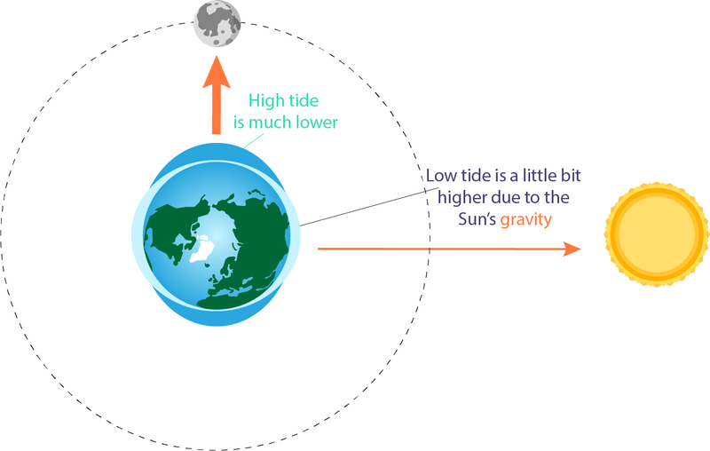

Slide 19
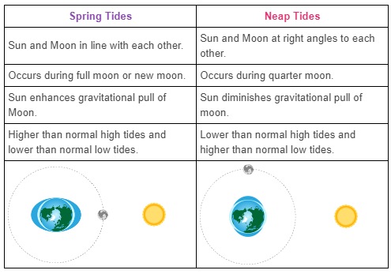
You should now know the difference between spring tides and neap tides! Here is a summary of the differences:

